Slide 1

UK FinTech Hackathon 2021
IDMachine Team

Slide 2
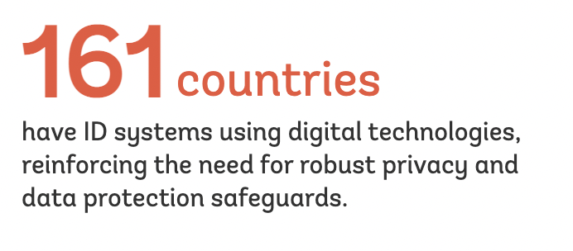
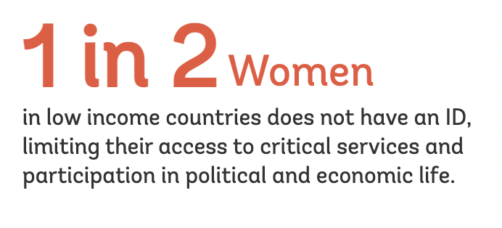
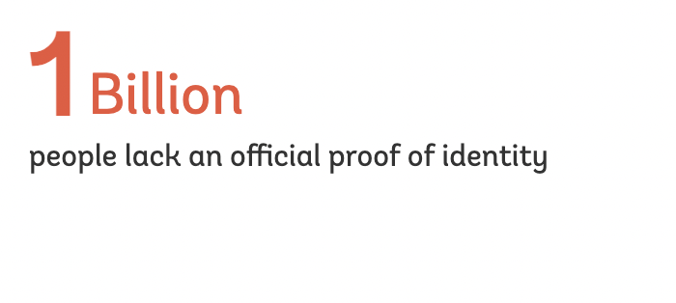
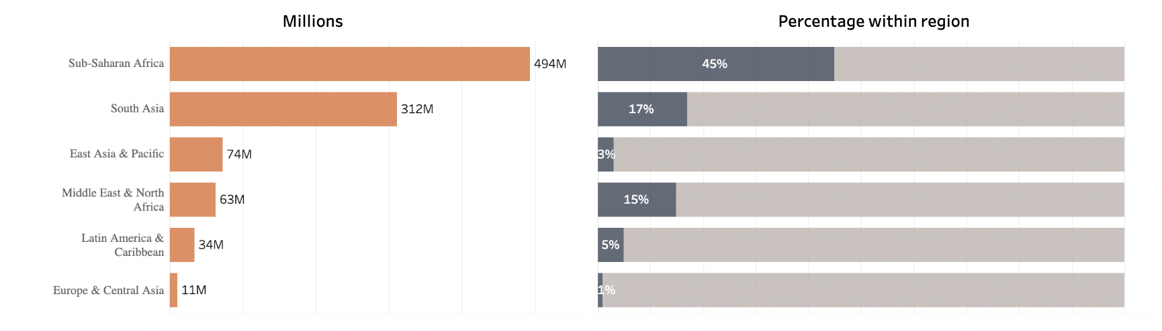
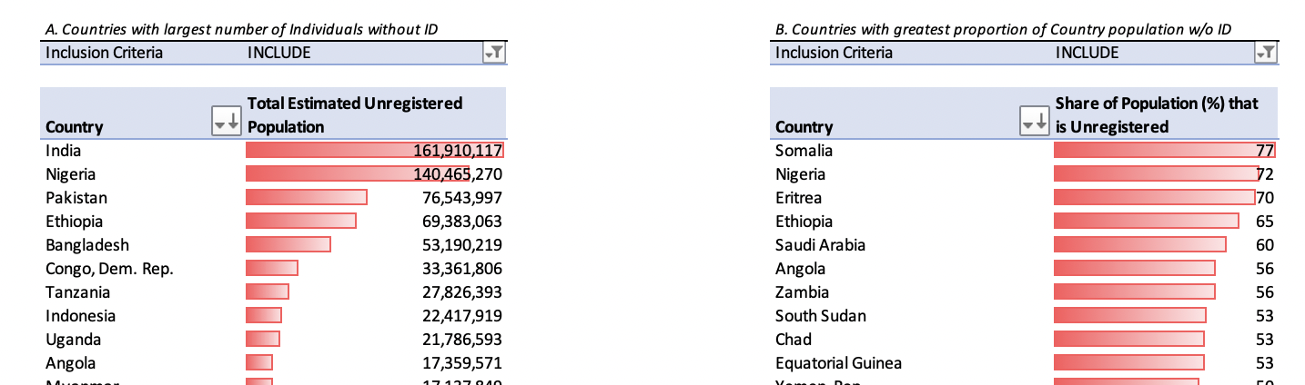
Problem
The majority live in Africa and Asia
Nigeria has 72% of Unregistered population

Slide 3

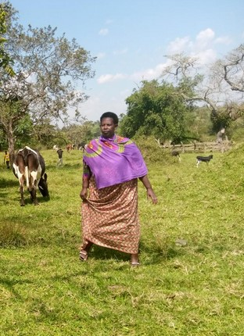
Adebi’s Journey to Government ID
Day’s worth of lost wages
Who will care for the children
Why do I even need this?
I don’t have the right documents
Meet Adebi, Nigerian, married with 5 children living in the rural village of Ikobi. Her dream is to ensure her children have a bright future.
Has:
A tight-knit community of neighbors in her village
Does not have:
Government ID
Access to credit to pay for her children’s school fees
The time or $ to go to the government office to apply for gov’t ID
4 hour walk
4 hour walk
Government office
Notes:
So instead of focusing on what Adebi does not have (government idea) we tried to focus on solving the problem with what she does have.

Slide 4



Challenges and Wins
Challenges
Nigeria – National ID linked to SIM cards - locked the unbanked out of their phones! https://techcabal.com/2020/12/18/on-ncc-new-sim-card-regulation/
Verification using database of faces
Helping Governments establish Digital ID
Data availability

Slide 5
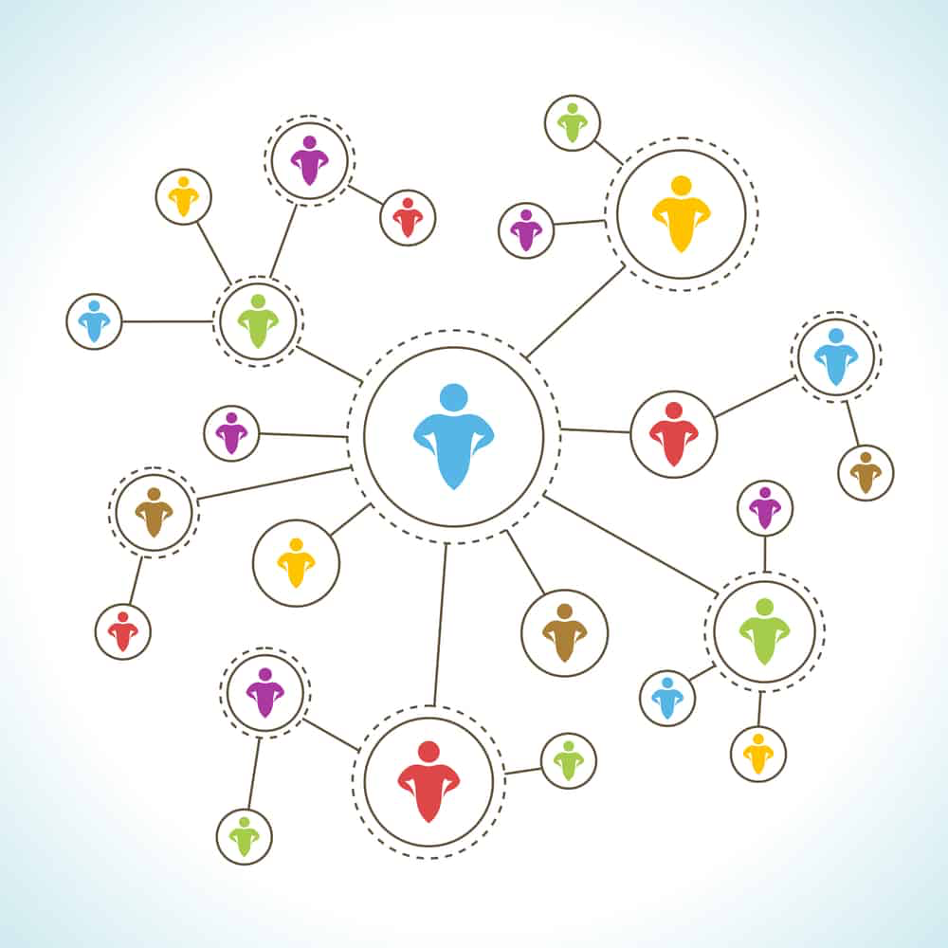
Harnessing the power of African communities
By understanding the family unit and network of village connections, we can ensure that when future generations come of age, they have access to the network and can be verified using data already collected.
We start by asking Adebi 20 easy questions:
What is your hometown?
How many children do you have?/their names?
When were your children born?
Who is your mother/father?
Then we ask the village to verify using group consensus.
The more connections made, the more trust is built in the system.

Slide 6


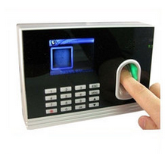
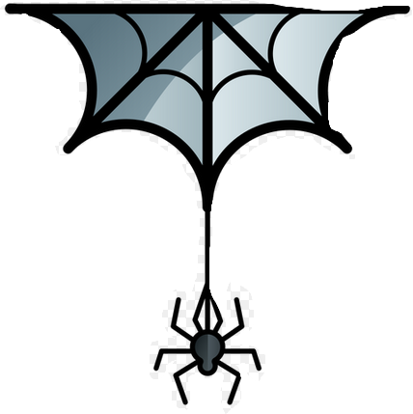
Solution: The IDMachine
Explainable, auditable machine learning model
Gives a confidence level to empower merchants/governments/banks to make a risk-based decision
Any documents + group consensus score
The ID Machine
Verified ID Confidence score - 80%
VerifyBots
Open API Gov’t
NGO Education Records
Vaccination Records
Notes:
Machine learning model

